Slide 1


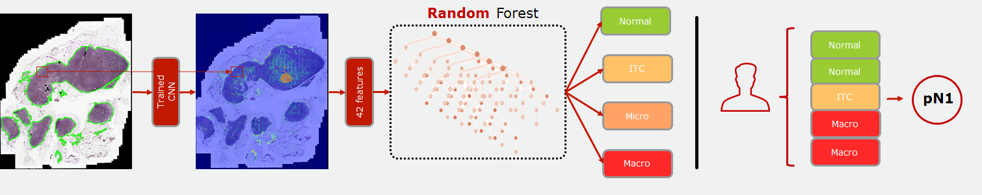
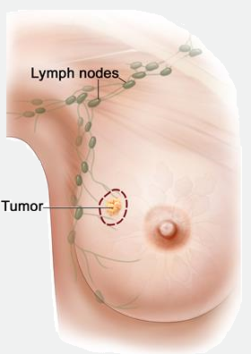
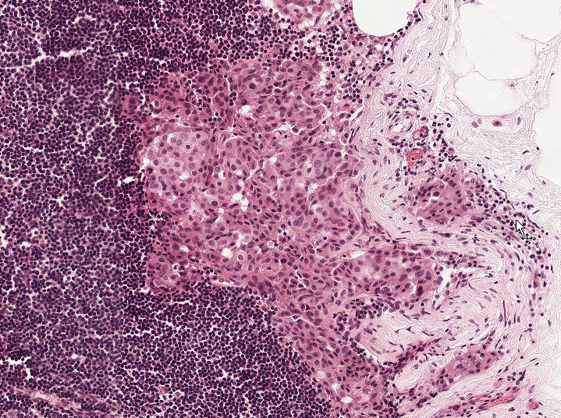
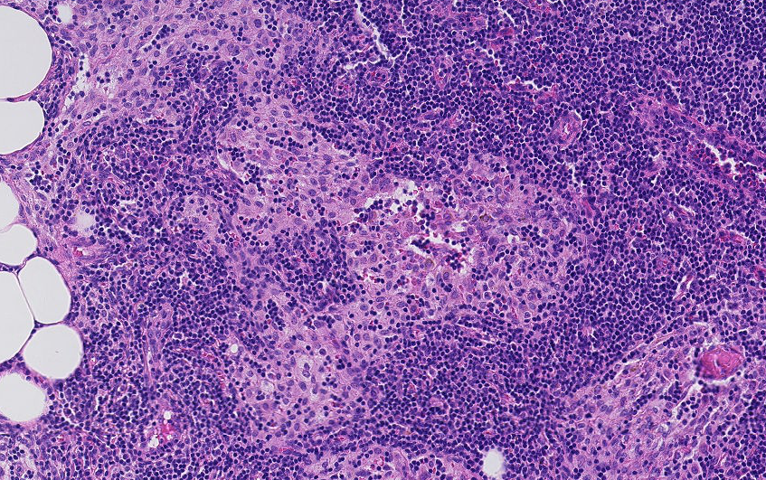
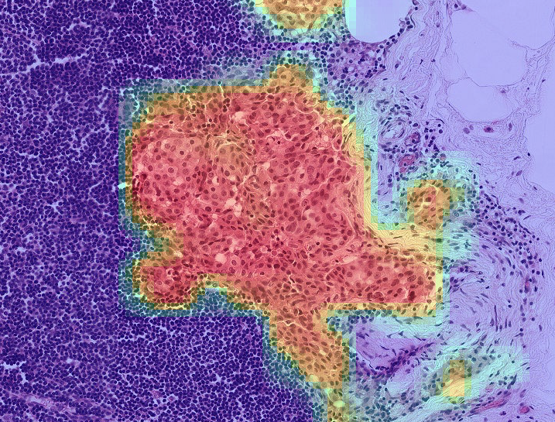
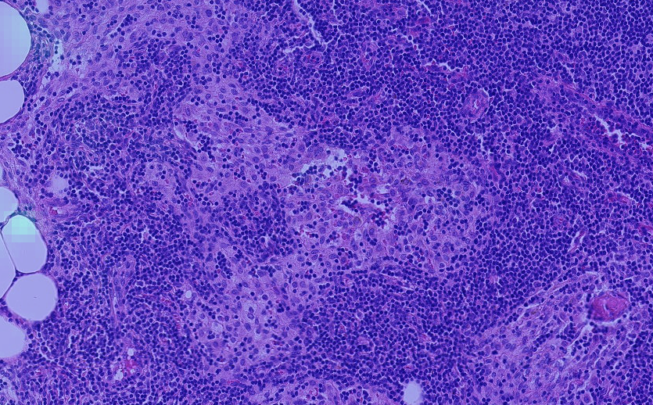
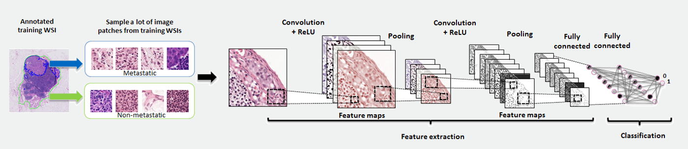
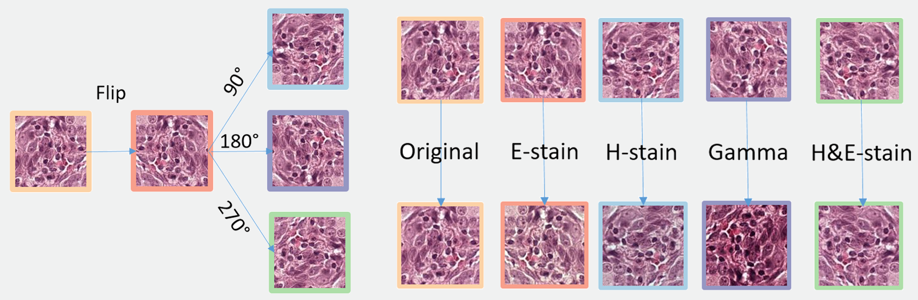


Efficient nuclei detection and classification with deep learning
Peter Grønborg, Mathematical Modelling and Computing, Technical University of Denmark
We use deep learning to automatically detect and classify breast cancer metastases, providing crucial information for the prognosis and treatment decision of breast cancer. Our method qualified for IEEE International Symposium on Biomedical Imaging 2017 Grand Challenge CAMELYON17 Melbourne, Australia. We were ranked 5th out of 23 qualifying teams of international research groups and commercial teams, with a marginal score difference to the winner of the CAMELYON17 competition.
Introduction
Breast cancer is the most common cancer disease for women worldwide (2012), where metastatic involvement of lymph nodes is one of the most important prognostic factors. Therefore, it is crucial to quickly determine if and which lymph node(s), the tumor has spread to.
Pathologists usually examine metastases in the lymph nodes by measuring the size of the tumor and/or counting the number of tumor cells. Thus, they manually categorize the type of metastases into macro metastases, micro metastases or isolated tumor cells (ITC), see Table 1. Assessment of multiple lymph nodes are then combined into a pN-stage for a single patient, see Table 2. However, this procedure is very labor intense for the examining pathologist and most importantly, small metastases are very difficult to detect and sometimes they are missed.
Figure 5: Whole-slide image inference and classification Inference of histology gigapixel images is followed by post-processing and feature extraction for WSI classification.
Figure 6: Patient classification 5 WSI analysis determines the pN-stage
Figure 1: Breast cancer and lymph node localization. It is most likely to be the lymph node(s) located in the axilla which the cancer spreads to first, when the patient has breast cancer.
Methods
Preprocessing Tissue detection at low-resolution using algorithm developed in Visiopharm Integrator System (VIS) (Visiopharm A/S, Denmark)
Sampling Uniform random sampling from both classes followed by hard negative mining.
Data augmentation Spatial transformations (flip, rotations) combined with H&E-stain specific augmentation scheme, creating more stain variation than available in the data. See below.
Implementation details We implement and train a convolutional neural network based on the Inception V3 architecture [1] to discriminate between metastatic tissue and non-metastatic tissue.
WSI inference We use a sliding window analysis where each non-overlapping patch is assigned a tumor probability p = [0,1] creating a 2D-tumor probability distribution, i.e. tumor heatmap.
Post-processing We threshold the tumor probability distribution p > 0.5 and find the 5 largest metastases M based on area.
Classification We train a random forest-classifier on features extracted from M to discriminate between macro, micro, ITC or normal WSIs.
Figure 7: True positive tumor region Top: Shows metastatic tissue with cancer cells surrounded by lymphatic tissue. Buttom: Probability heatmap with high probability of tumor (red).
Figure 8: True negative normal region Top: Shows normal tissue (macrophages etc.) surrounded by lymphatic tissue. Buttom: Probability heatmap with low probability of tumor (blue). Illustrate difficult regions that looks similar to metastatic regions.
Results
Our method reaches a weighted kappa value of 0.8172 on the challenge test set (100 patients), showing very good agreement between our algorithm and the human pathologist.
Figure 2: Training Framework We sample millions of patches (128x128 pixels) from whole slide images (WSI) to train a convolutional neural network to distinguish between metastastic and normal tissue, i.e. a binary classification problem. We use a slightly modified version of the Inception V3 [1] (the achitecture shown are only for illustration purposes).
Figure 4: Stain augmentation
Randomly vary the H&E-stains, indepently and together, to force network to learn stain variations. Gamma-correction to augment scanner variance.
Conclusions and future work
We demonstrate a deep learning-based approach to analyze and diagnose breast cancer metastases in whole-slide images of histological lymph node sections. Our method could also be implemented as a screening-tool that significanly decrease the clinical workload. Future work will focus on optimizing stain-augmentation and increasing sensitivity towards ITCs.
Figure 3: Spatial transformations
Macro: metastases greater than 2.0 mm.
Micro: metastases greater than 0.2 mm or more than 200 cells, but smaller than 2.0 mm.
ITC: Single tumor cells or a cluster of tumor cells smaller than 0.2 mm or less than 200 cells
pN0: No micro-metastases or macro-metastases or ITCs found.
pN0(i+): Only ITCs found.
pN1mi: Micro-metastases found, but no macro-metastases found.
pN1: Metastases found in 1–3 lymph nodes, of which at least one is a macro-metastasis.
pN2: Metastases found in 4–9 lymph nodes, of which at least one is a macro-metastasis.
References
[1] Szegedy, C., Vanhoucke, V., Ioffe, S., Shlens, J., & Wojna, Z. (2016). Rethinking the inception architecture for computer vision.
In Proceedings of the IEEE Conference on Computer Vision and Pattern Recognition (pp. 2818-2826)..
[2] https://camelyon17.grand-challenge.org/results
Table 1 Metastases subtypes and WSI classifcation.
Table 2 pN-stage definitions
Scan for leaderboard [2]

